Slide 1



Hotel
Reservation
Analysis With SQL
PRESENTED BY
FASANYA TAIWO
BATCH MIP-DA-10

Slide 2
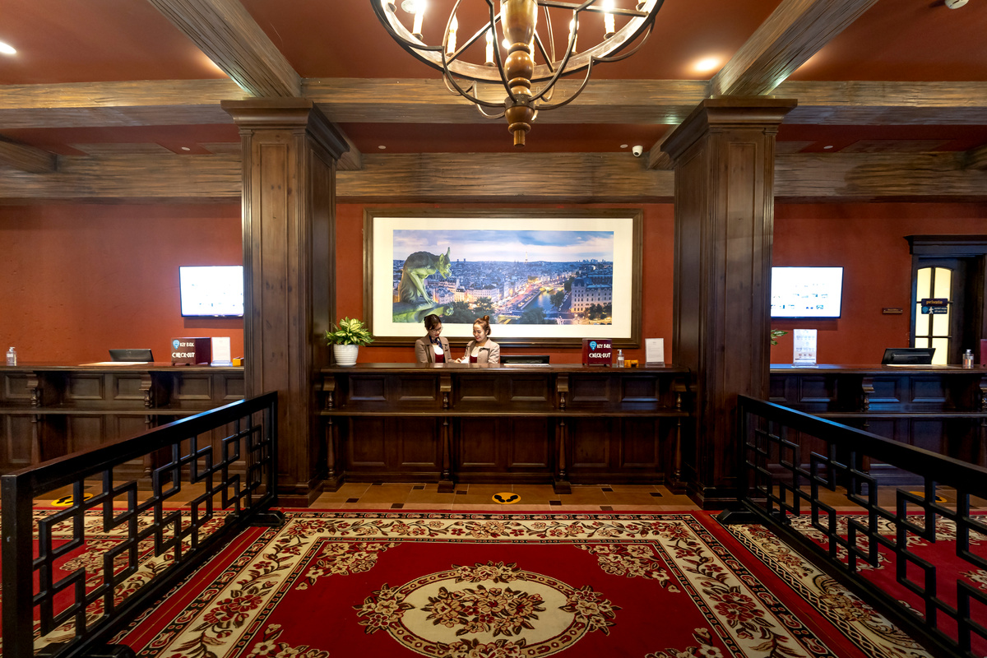

About
INTRODUCTION
The hotel industry relies on data to make informed decisions necessary for improving guest experiences, optimizing operations, and driving revenue. The aim of this analysis is to extract key insights such as the most popular meal plan among the guests, the most commonly booked room type and the market segment generating the highest average price per room among others, using SQL queries.
Read More

Slide 3
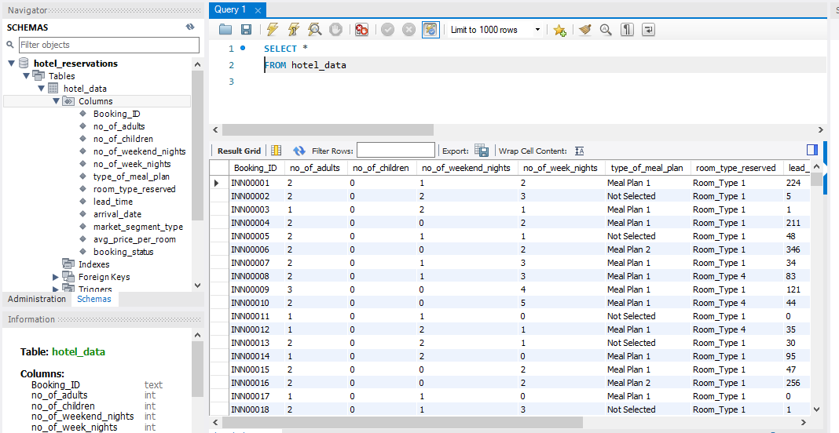
The Dataset
About

Slide 4


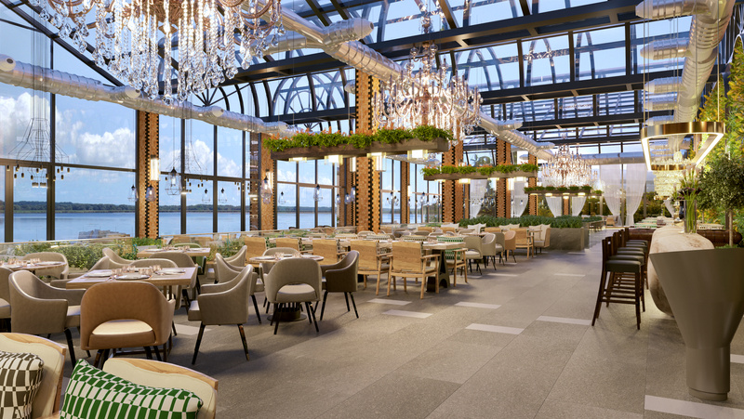
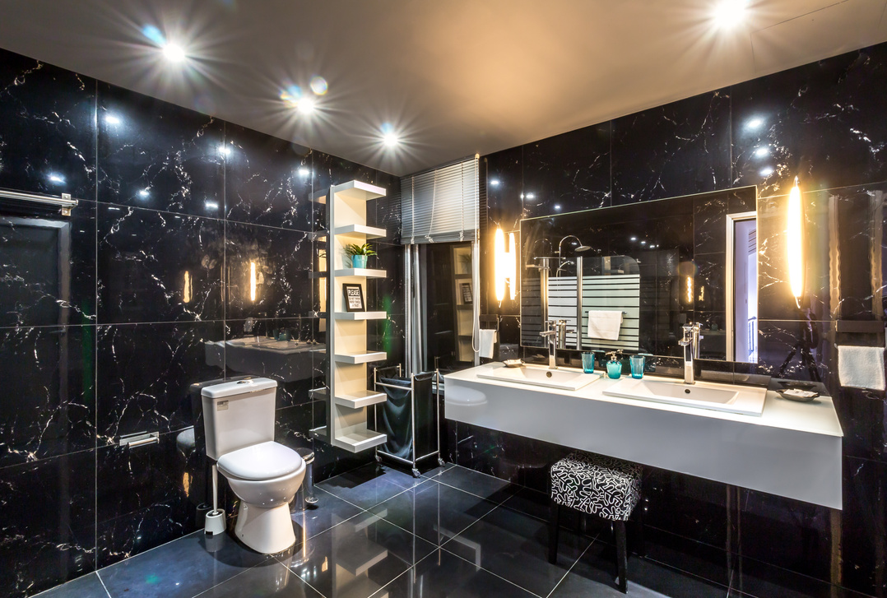

Column Descriptions
Booking_ID: A unique identifier for each hotel reservation.
No_of_adults: The number of adults in the reservation.
No_of_children: The number of children in the reservation.
No_of_weekend_nights: The number of nights in the reservation that fall on weekends.
No_of_week_nights: The number of nights in the reservation that fall on weekdays.
Type_of_meal_plan: The meal plan chosen by the guests.
Room_type_reserved: The type of room reserved by the guests.
Lead_time: The number of days between booking and arrival.
Arrival_date: The date of arrival.
Market_segment_type: The market segment to which the reservation belongs.
Avg_price_per_room: The average price per room in the reservation.
Booking_status: The status of the booking.
Read More

Slide 5
Insights….

Slide 6
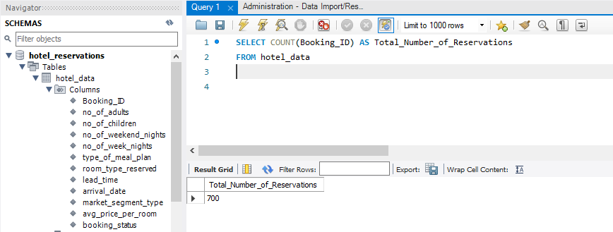
Total Number Of Reservations
700

Slide 7
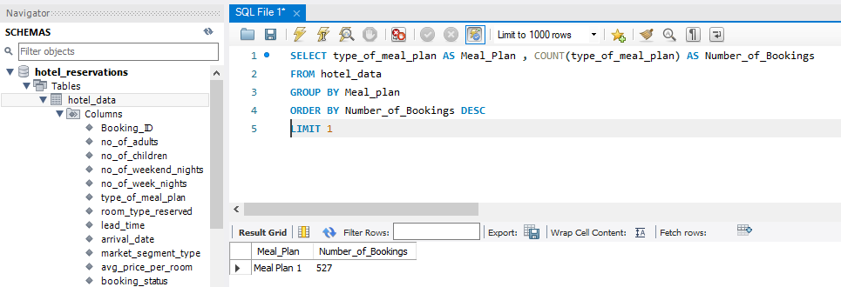
Most Popular Meal Plan
Meal Plan 1

Slide 8
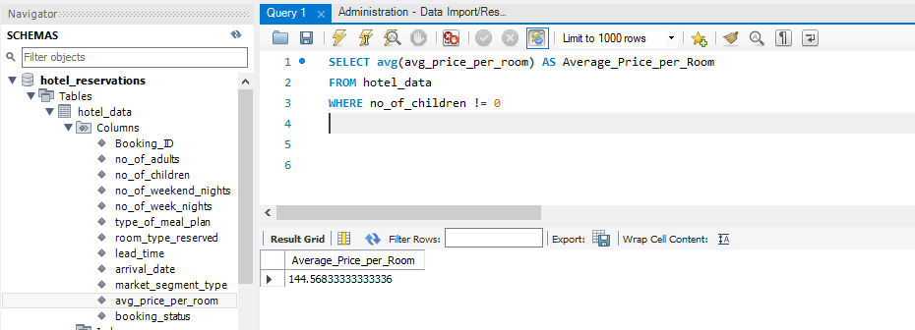
Average Price Per Room for Reservations Involving Children
$ 144.56

Slide 9
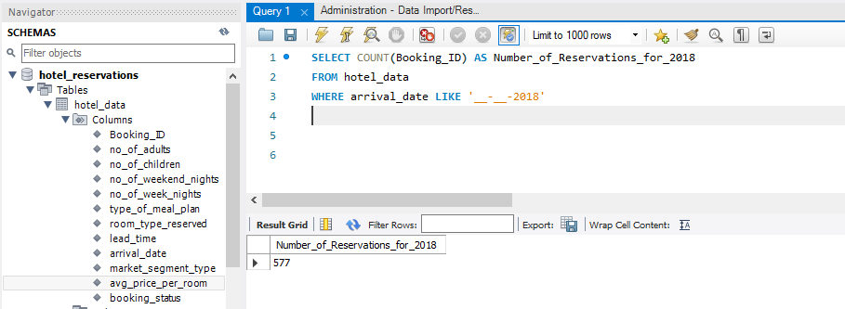
Number of Reservations Made in 2018
577

Slide 10
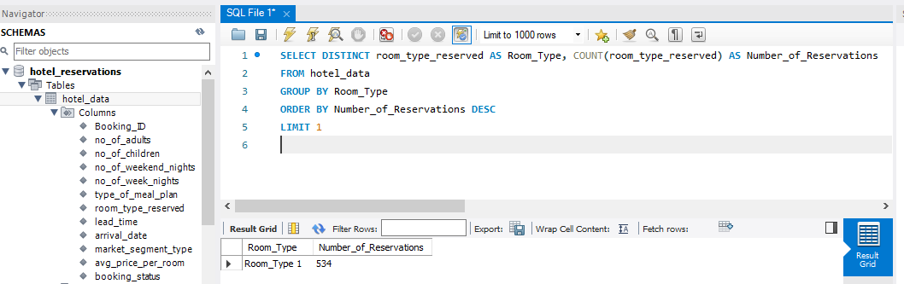
Most Commonly Booked Room Type
Room Type 1

Slide 11
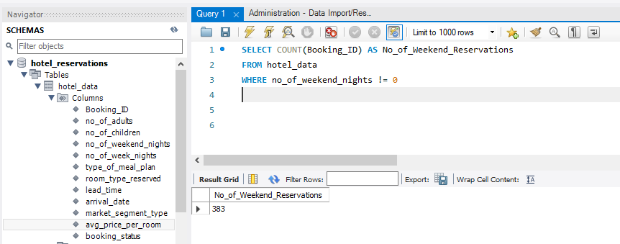
Number Of Reservations Falling On A Weekend
383

Slide 12
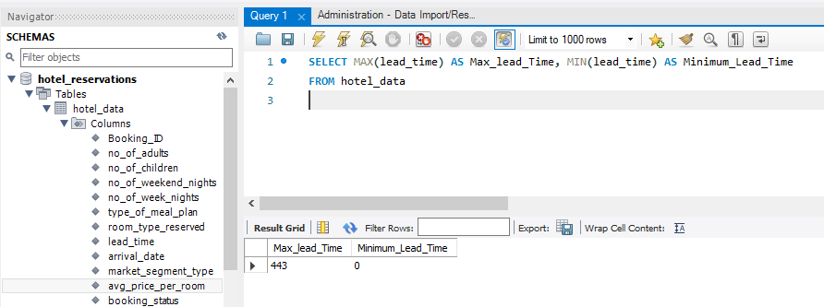
Highest and Lowest Lead Times For Reservations
Highest Lead Time: 443
Lowest Lead Time: 0

Slide 13
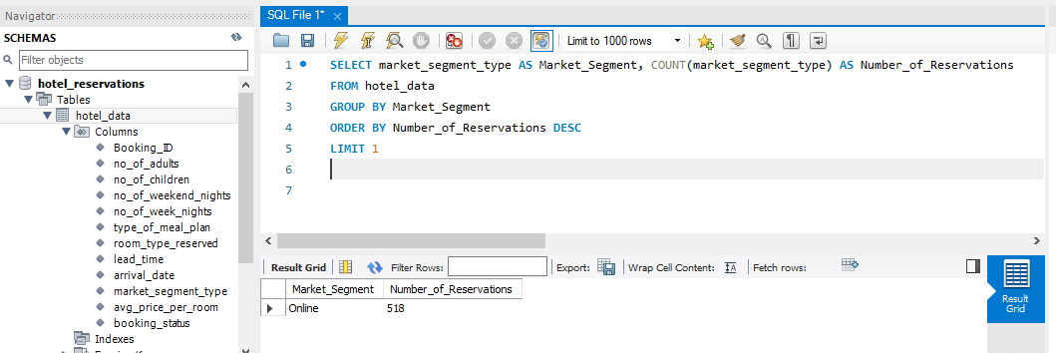
Most Common Market Segment Type For Reservations
Online

Slide 14
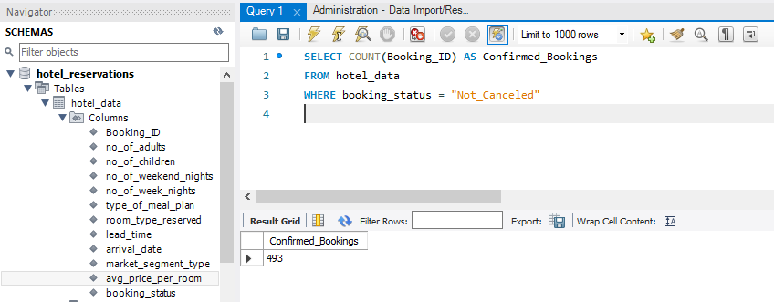
Number Of Reservations Having Booking Status Of “Confirmed”
493

Slide 15
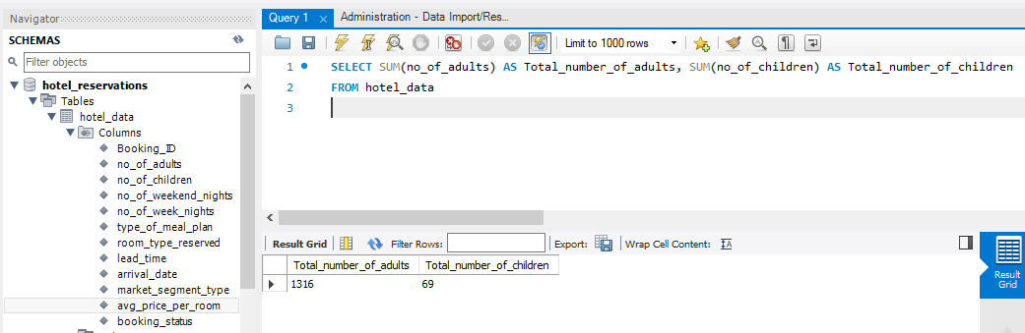
Total Number Of Adults And Children Across All Reservations
Number of Adults: 1316
Number of Children: 69

Slide 16
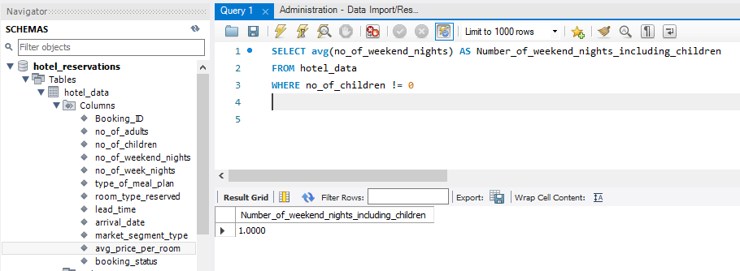
Average Number Of Weekend Nights For Reservations Involving Children
1

Slide 17
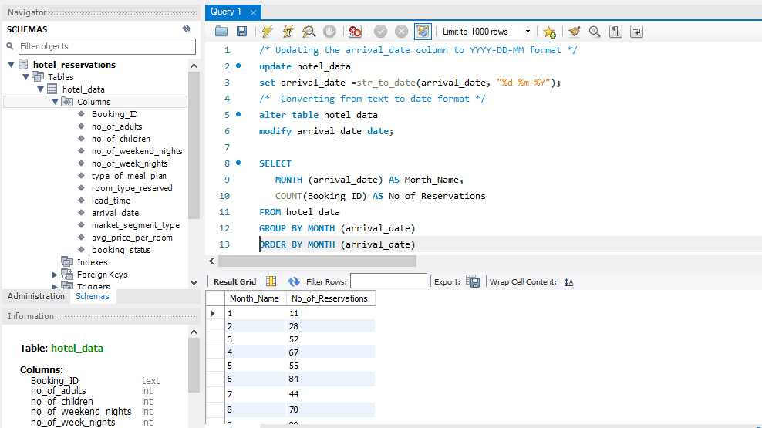
Number Of Reservations Per Month

Slide 18
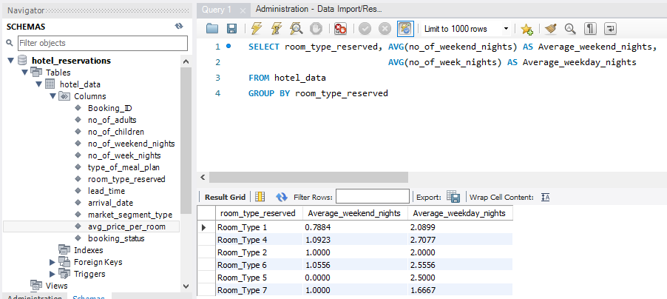
Average Number Of Weekend And Weekday Nights Spent By Guests For Each Room Type

Slide 19
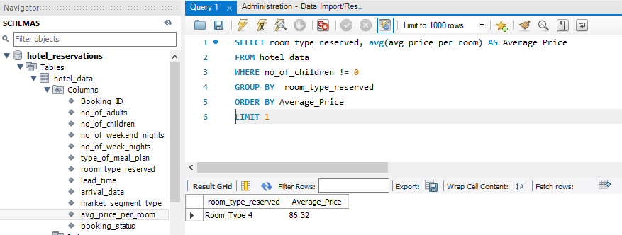
Most Common Room Type For Reservations Involving Children And Its Average Price
Room Type: 4
Average Price: $ 86.32

Slide 20
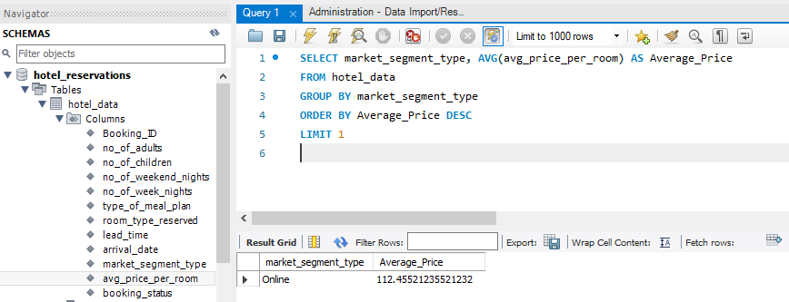
Market Segment Type Generating The Highest Average Price Per Room
Online

Slide 21
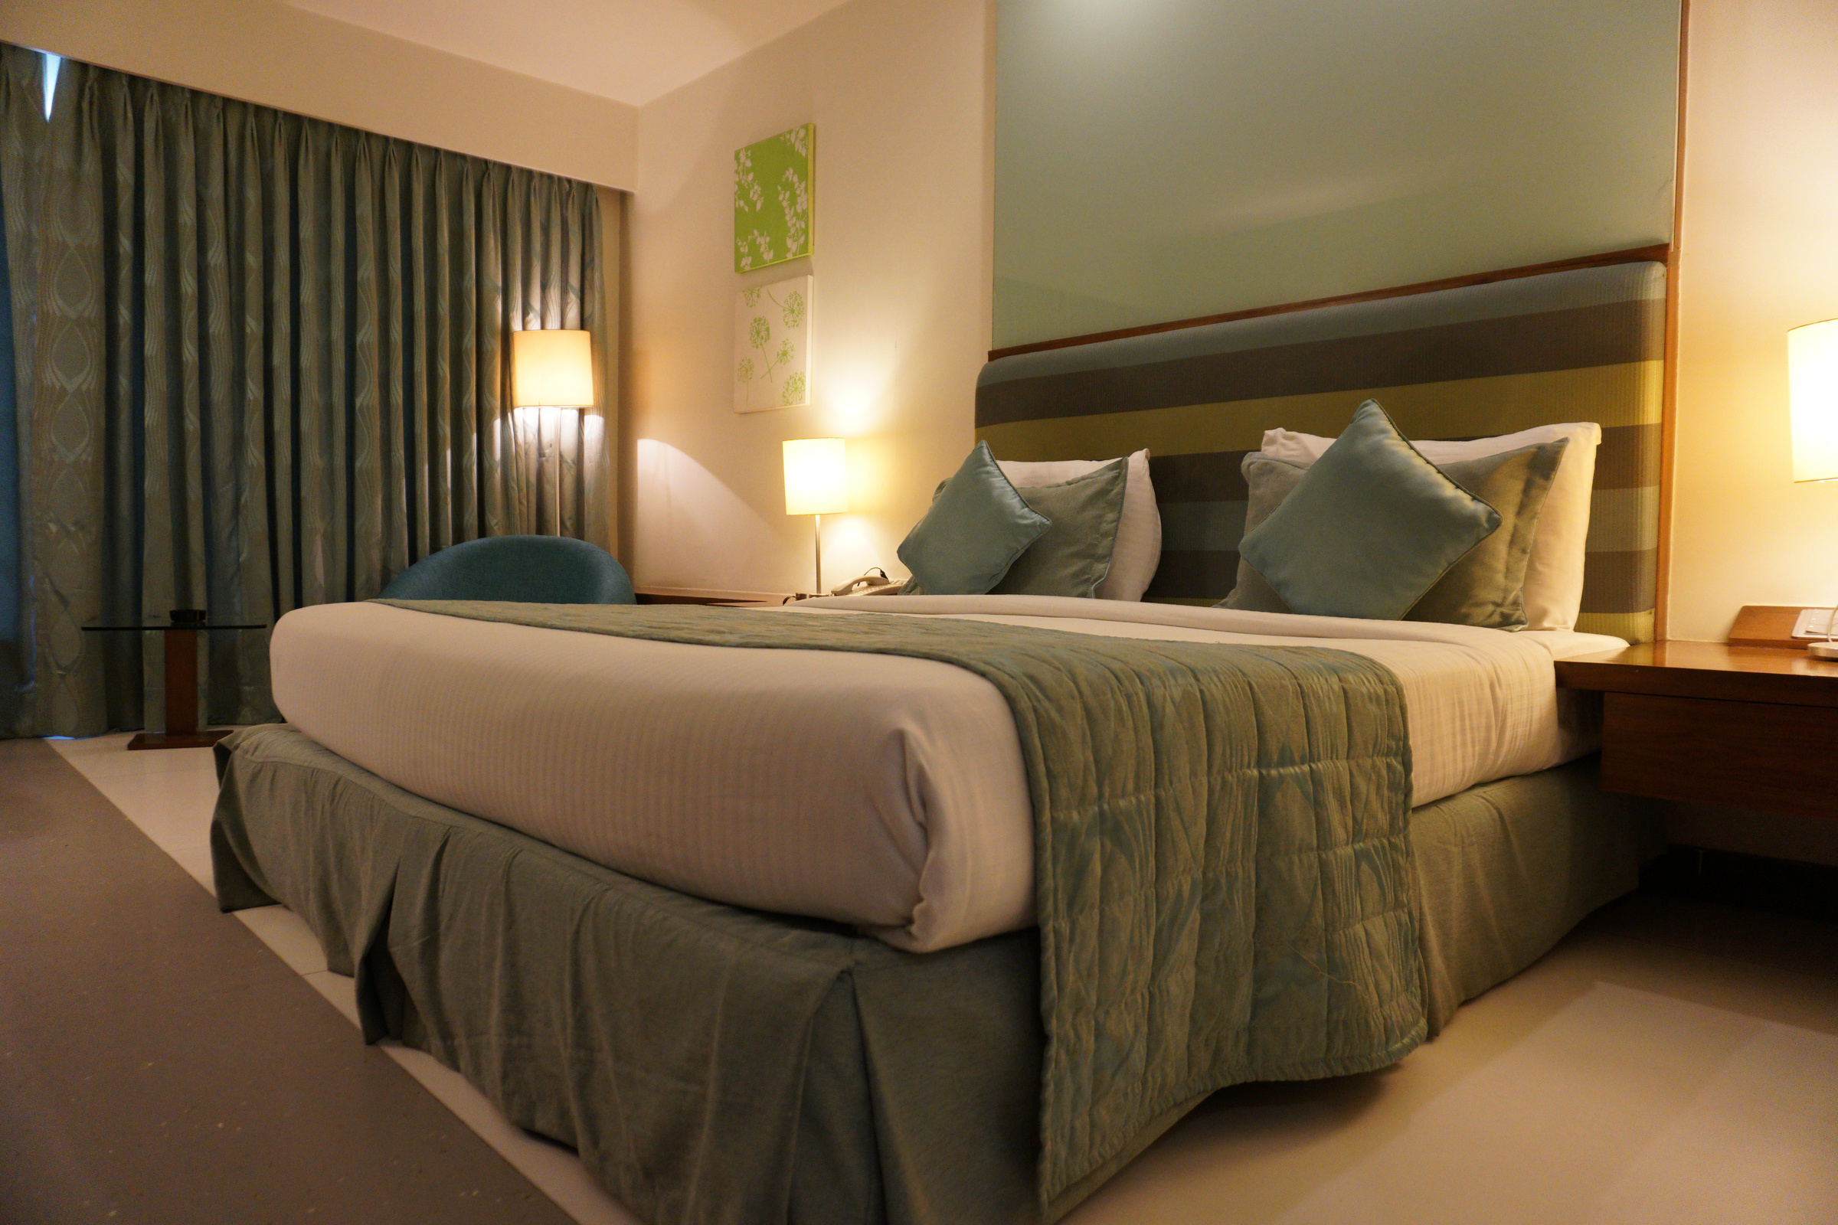
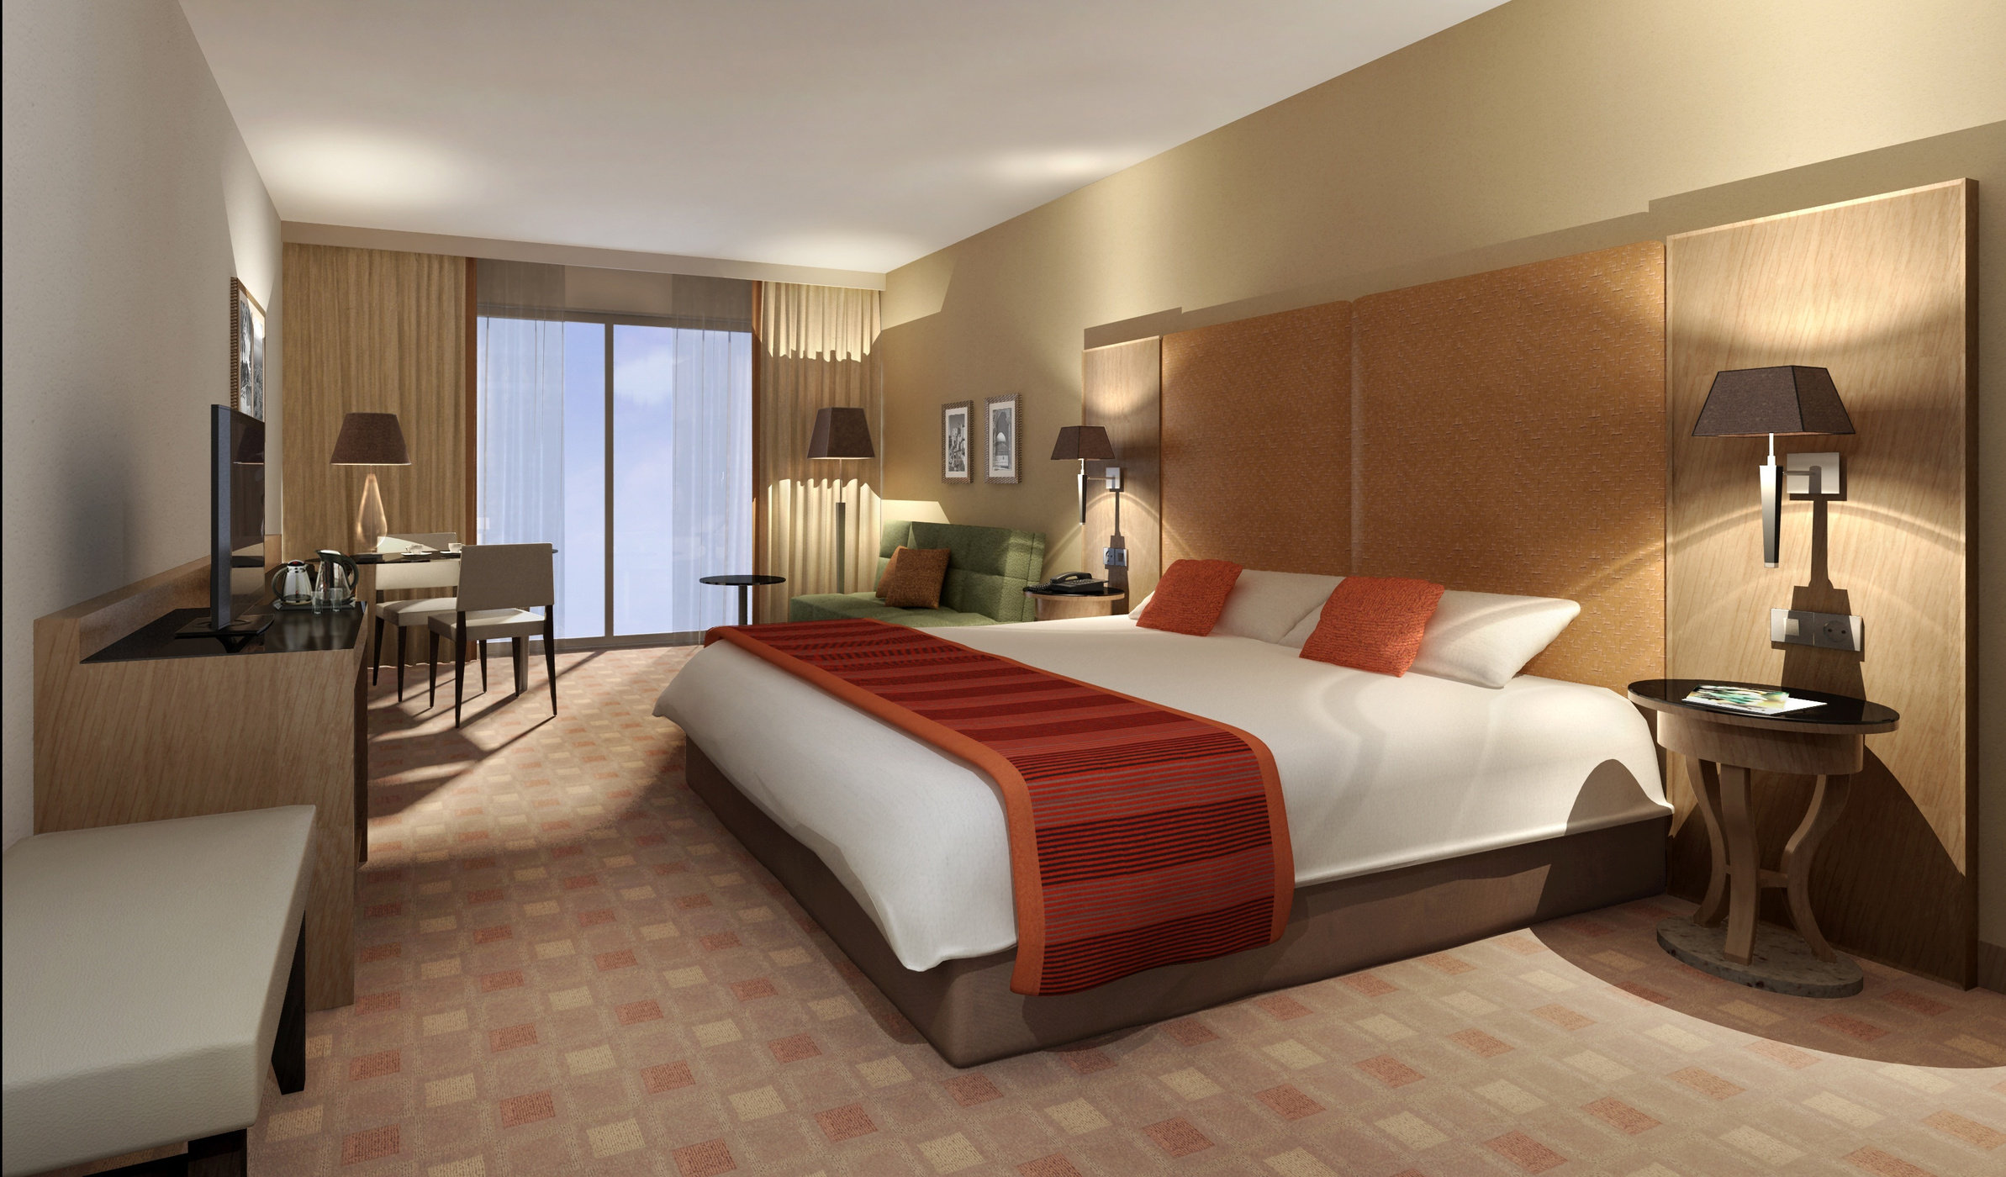
Conclusion
This Analysis has employed the use of SQL queries to extract key insights necessary to help the hotel understand the reservation behavior of their customers. Some insights drawn include the most popular meal plan being Meal plan 1, and the Online segment was found to be the most common market segment type for reservations, generating the highest average price per room. Leveraging these insights will help the hotel to make data-driven decisions that boost guest satisfaction, promoting operational efficiency and revenue growth.

Slide 22




Recommendations
About
1
The hotels should promote Meal Plan 1 more heavily in their marketing materials. This can attract potential guests who value convenience and prefer choosing options that have been well-received by others, leading to an increase in bookings.
2
The hotel should focus more efforts on expanding the online market segment through the development of new services or amenities that would appeal to these guests.
3
The hotel should ensure that they maintain an adequate inventory of Room Type 1, since it is the most commonly booked, in order to avoid overbooking or under booking situations.

Slide 23
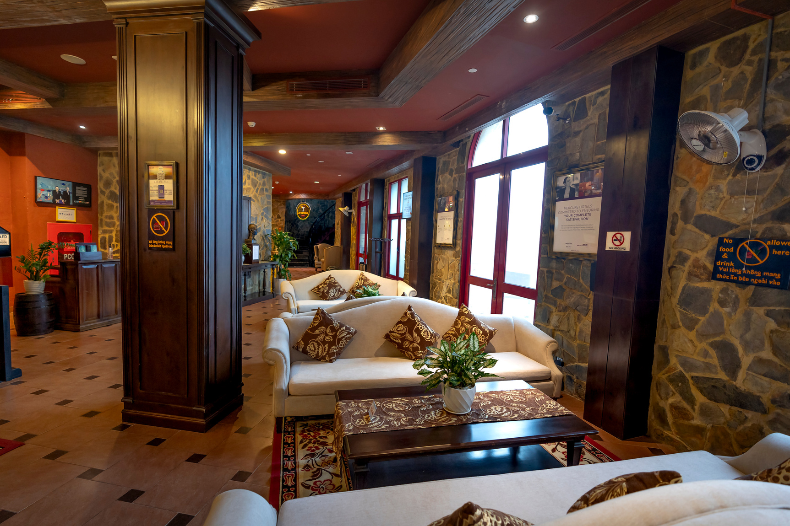
About
Thank You
FOR YOUR ATTENTION

